Slide 1
Supporting and Enhancing Mathematics and Statistics
UNIT: Fraction Calculations

Slide 2
UNIT:
Fraction Calculations
Fraction Calculations
It is important to be able to complete Fraction Calculations so that you see and understand how to manipulate fractions in a variety of calculations.
There are three sections in this Unit, namely:
Addition and Subtraction of Fractions
Multiplying Fractions
Dividing Fractions

Slide 3
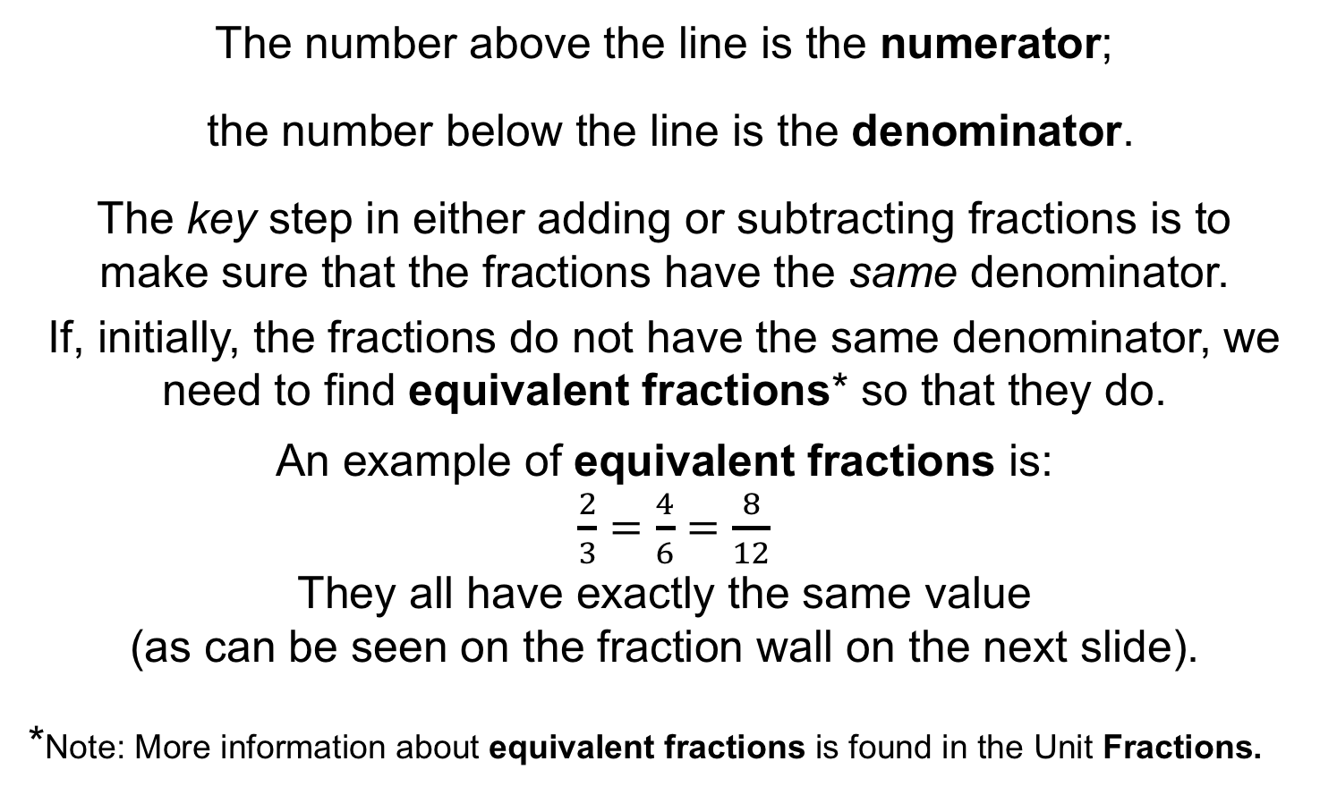
UNIT:
Fraction Calculations
Section 1
Addition and Subtraction of Fractions
We start with a quick review of key facts about fractions:
The number above the line is the numerator;
the number below the line is the denominator.
The key step in either adding or subtracting fractions is to
make sure that the fractions have the same denominator.
If, initially, the fractions do not have the same denominator, we need to find equivalent fractions* so that they do.
An example of equivalent fractions is:
$\frac{2}{3}=\frac{4}{6}=$ $\frac{8}{12}$
They all have exactly the same value
(as can be seen on the fraction wall on the next slide).
*Note: More information about equivalent fractions is found in the Unit Fractions.

Slide 4
UNIT:
Fraction Calculations
Section 1
Fraction Wall for Equivalent Fractions

Slide 5
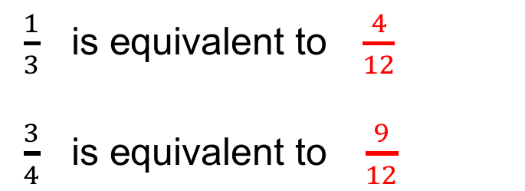
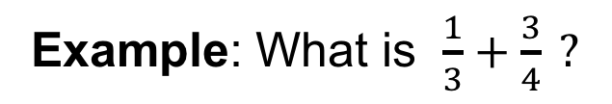
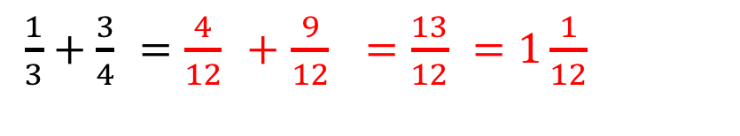
UNIT:
Fraction Calculations
Section 1
Addition of Fractions: Example
Example: What is $\frac{1}{3}+\frac{3}{4} ?$
Solution
These fractions do not have the same denominator so
we need to find equivalent fractions for each, so that
the two fractions have common (the same) denominators.
$\frac{1}{3} \text{is} \text{equivalent} \text{to} \frac{4}{12}$
$\frac{3}{4} \text{is} \text{equivalent} \text{to} \frac{9}{12}$
$\frac{1}{3}+\frac{3}{4}$ $=$ $\frac{4}{12}$ $+$ $\frac{9}{12}$ $=$ $\frac{13}{12}$ $=1\frac{1}{12}$

Slide 6
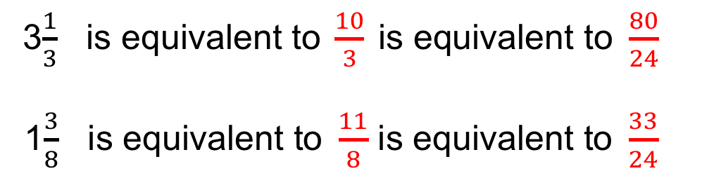
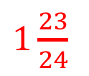

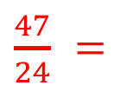
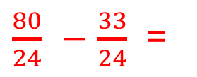
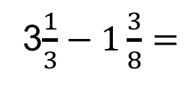
UNIT:
Fraction Calculations
Section 1
Subtraction of Fractions: Example
Example: What is 3$\frac{1}{3} − 1\frac{3}{8} ?$
Solution
These fractions do not have the same denominator,
so we need to find equivalent fractions for each,
so that the two fractions have a common denominator.
3$\frac{1}{3} \text{is} \text{equivalent} \text{to} \frac{10}{3} \text{is} \text{equivalent} \text{to} \frac{80}{24}$
1$\frac{3}{8} \text{is} \text{equivalent} \text{to} \frac{11}{8}$ $\text{is} \text{equivalent} \text{to} \frac{33}{24}$
3$\frac{1}{3}−1\frac{3}{8}=$
$\frac{80}{24}$ $−$ $\frac{33}{24}$ =
$\frac{47}{24}$ $=$
$1\frac{23}{24}$

Slide 7
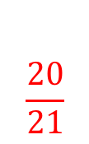
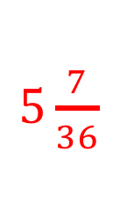
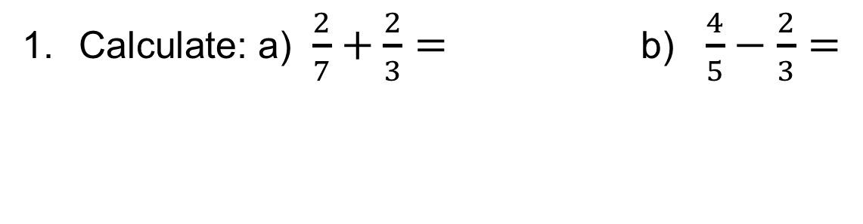

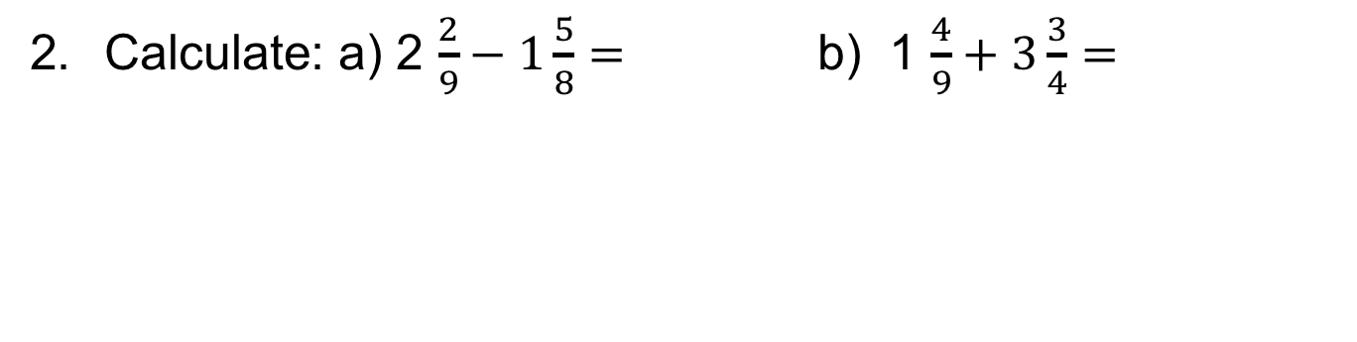
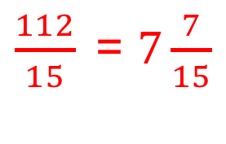
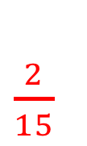

UNIT:
Fraction Calculations
Section 1
Section 1: Fitness Check
$$\frac{20}{21}$$
$\frac{2}{15}$
Calculate: a) $\frac{2}{7}+\frac{2}{3}=$b) $\frac{4}{5}−\frac{2}{3}=$
$5\frac{7}{36}$
$\frac{43}{72}$
Calculate: a) 2 $\frac{2}{9}−1\frac{5}{8}=$ b) 1 $\frac{4}{9}+3\frac{3}{4}=$
$\frac{11}{14}$
$\frac{112}{15}$= $7\frac{7}{15}$
Calculate: a) 2 $\frac{1}{2}−1\frac{5}{7}=$ b) 6 $\frac{4}{5}+\frac{2}{3}=$

Slide 8
UNIT:
Fraction Calculations
Section 1
Section 1: Review
You have completed the first Section.
If you have completed and mastered this section,
click to start the next Section.
If you need more examples and interactive practice,
press here.
You might also find it helpful to look at:
Essential Information: press here

Slide 9
UNIT:
Fraction Calculations
Section 2
Multiplying Fractions
We start with a quick review of key facts:
Multiplying fractions is probably the easiest
fraction calculation.
You do NOT need the same denominator.
You simply find the product of the numerators
(multiply them together).
Then find the product of the denominators
(multiply them together).
Then simplify, if necessary*.
*Note: More information about simplifying fractions is found in the Unit Fractions.

Slide 10
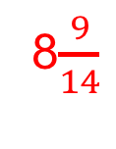
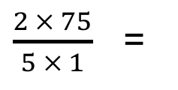
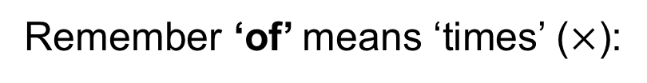
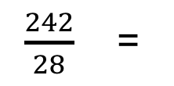
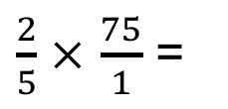
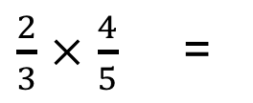
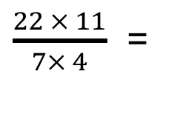
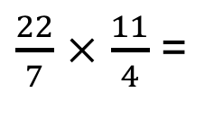
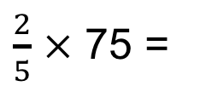
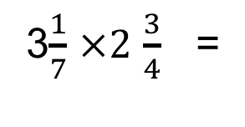
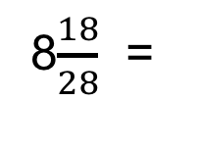
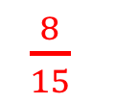
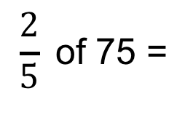
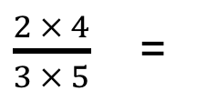
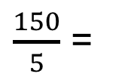
UNIT:
Fraction Calculations
Section 2
Multiplying Fractions
To multiply fractions
multiply the numerators, and
multiply the denominators;
simplify, if needed.
$\frac{2}{3}$ $×$ $\frac{4}{5}$ =
$\frac{2 × 4}{3 × 5}$ =
$\frac{8}{15}$
Remember ‘of’ means ‘times’ ($×$):
$$\frac{2}{5} \text{of}\text{ 75 }\text{=}$$
$\frac{2}{5}$ $×$ 75 =
$\frac{2}{5}$ $×$ $\frac{75}{1}$ =
$\frac{2 × 75}{5 × 1}$ =
$\frac{150}{5}$ =
30
Convert mixed numbers to improper (top-heavy) fractions first:
3$\frac{1}{7}$ $×2$ $\frac{3}{4}$ =
$\frac{22}{7}$ $×$ $\frac{11}{4}$ =
$\frac{22 × 11}{7× 4}$ =
$\frac{242}{28}$ =
8$\frac{18}{28}$ =
8$\frac{9}{14}$

Slide 11

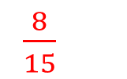
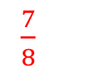

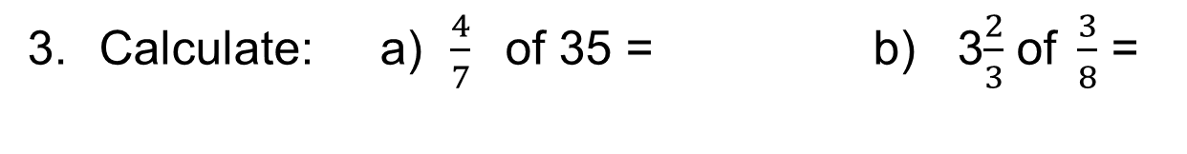
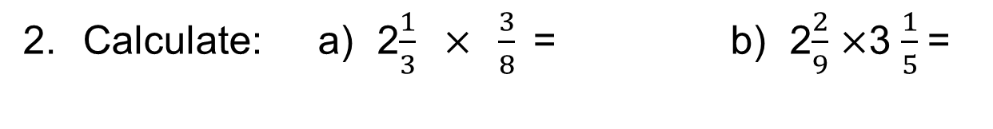

UNIT:
Fraction Calculations
Section 2
Section 2: Fitness Check
1. Calculate: a) $\frac{2}{3} × \frac{4}{5}\text{ =}$ b) $\frac{3}{8}$ $×$ $\frac{4}{5}$ =
$\frac{3}{10}$
$\frac{8}{15}$
Calculate: a) 2$\frac{1}{3} × \frac{3}{8}\text{ =}$ b) 2$\frac{2}{9}$ $×$3 $\frac{1}{5}$=
7$\frac{1}{9}$
$\frac{7}{8}$
Calculate: a) $\frac{4}{7} \text{of}\text{ 35 }\text{=}$ b) 3$\frac{2}{3}$ $\text{of} \frac{3}{8}$ =
1$\frac{3}{8}$
20

Slide 12
UNIT:
Fraction Calculations
Section 2
Section 2: Review
You have completed the second Section.
If you have completed and mastered this section,
click to start the next Section.
If you need more examples and interactive practice,
press here.
You might also find it helpful to look at:
Essential Information: press here

Slide 13
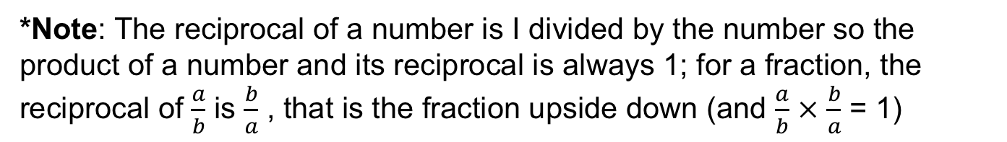
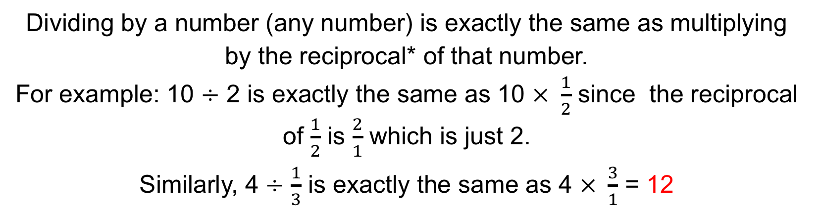
UNIT:
Fraction Calculations
Section 3
Dividing Fractions
We start with a quick review of key facts:
Dividing by a number (any number) is exactly the same as multiplying
by the reciprocal* of that number.
For example: 10 $÷$ 2 is exactly the same as 10 $× \frac{1}{2}$ since the reciprocal of $\frac{1}{2}$ is $\frac{2}{1}$ which is just 2.
Similarly, 4 $÷$ $\frac{1}{3}$ is exactly the same as 4 $× \frac{3}{1}$ = 12
Simple steps to divide fractions
Turn the second fraction upside down (its reciprocal)
Multiply the first fraction by that reciprocal
Then simplify, if needed.
*Note: The reciprocal of a number is I divided by the number so the product of a number and its reciprocal is always 1; for a fraction, the reciprocal of $\frac{a}{b}$ is $\frac{b}{a}$ , that is the fraction upside down (and $\frac{a}{b}$ $×$ $\frac{b}{a}$ = 1)

Slide 14

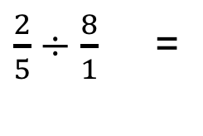
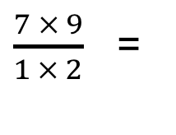
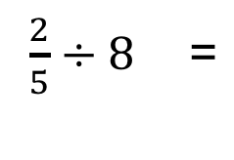
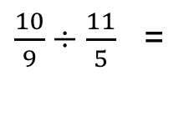
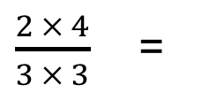
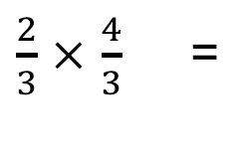
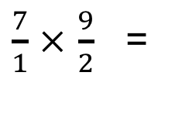
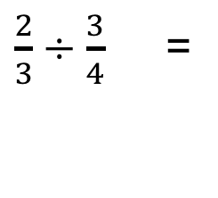
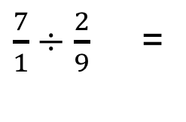
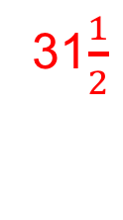

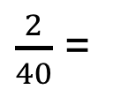
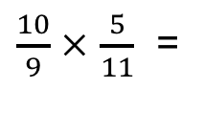
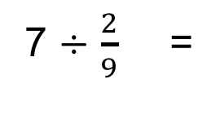
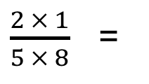





UNIT:
Fraction Calculations
Section 3
Dividing Fractions
To divide fractions
Turn the second fraction upside down (its reciprocal)
Then multiply the fractions
Simplify, if needed.
$\frac{2}{3}÷\frac{3}{4}$ =
$\frac{2}{3}$ $×$ $\frac{4}{3}$ =
$\frac{2 × 4}{3 × 3}$ =
$\frac{8}{9}$
$\frac{2}{5}÷\text{8} \text{=}$
$\frac{2}{5}÷\frac{8}{1}$ =
$\frac{2}{5}$ $×$ $\frac{1}{8}$ =
$\frac{2 × 1}{5 × 8}$ =
$\frac{2}{40}$ =
$\frac{1}{20}$
7 $÷$ $\frac{2}{9} \text{=}$
$\frac{7}{1}÷\frac{2}{9}$ =
$\frac{7}{1}$ $×$ $\frac{9}{2}$ =
$\frac{7 × 9}{1 × 2}$ =
$\frac{63}{2}$ =
31$\frac{1}{2}$
Convert mixed numbers to improper (top-heavy) fractions first:
1$\frac{1}{9}÷2\frac{1}{5}$ =
$\frac{10}{9}÷\frac{11}{5}$ =
$\frac{10}{9}$ $×$ $\frac{5}{11}$ =
$\frac{10 × 5}{9 × 11}$ =
$\frac{50}{99}$

Slide 15








UNIT:
Fraction Calculations
Section 3
Section 3: Fitness Check
$$\frac{5}{6}$$
$$\frac{16}{21}$$
1. Calculate: a) $\frac{2}{3}÷\frac{4}{5}\text{ =}$ b) $\frac{4}{7}÷\frac{3}{4}$ =
$$\frac{2}{9}$$
4$\frac{2}{3}$
Calculate: a) $\frac{2}{3}÷3\text{ =}$ b) $4÷\frac{6}{7}$ =
$\frac{28}{65}$
5$\frac{22}{25}$
Calculate: a) 1$\frac{2}{5}÷3\frac{1}{4}\text{ =}$ b) 4$\frac{1}{5}÷\frac{5}{7}$ =

Slide 16
UNIT:
Fraction Calculations
Section 3
Section 3: Review
You have completed the last Section.
If you have completed and mastered this last section,
click here for the Unit audit.
If you need more examples and interactive practice,
press here.
You might also find it helpful to look at:
Essential Information: press here

